Slide 1


TVS CREDIT E.P.I.C
Team Name
Suman Pal
College
IIM Calcutta
FINANCIAL DELINQUENCY PREDICTIVE ANALYSIS
Name of the Participants
Suman Pal

Slide 2
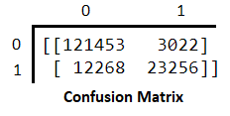

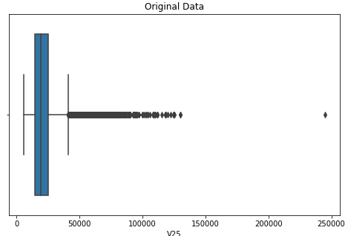
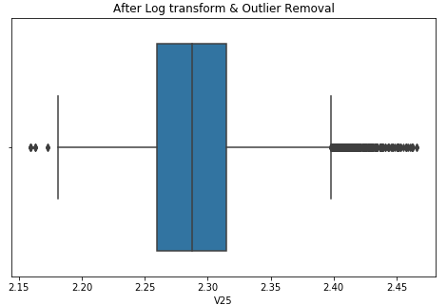
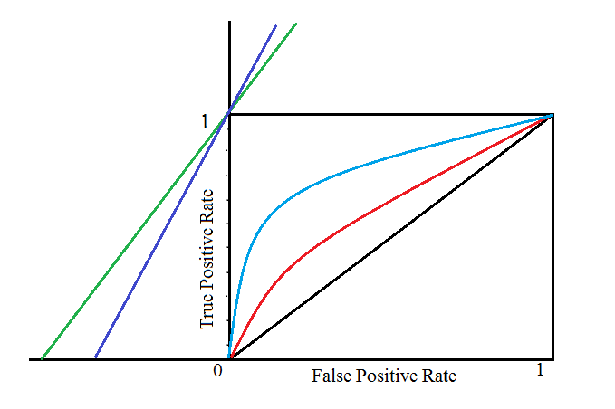
TVS credit, a financial services company under TVS group, operating across 21 states, aims to empower Indians from various socioeconomic backgrounds with financial products serving their needs.
The new venture into consumer durables in 2017 poses certain challenges for the company with respect to tracking and recovery from prospective loan defaulter.
Data Pre-processing:
The variable V1 (Cust_ID) have been ignored and the variables V28 to V31 have been imputed with the following strategies:
a) V28 to V30 represent the no. of times the customers were past 30,90 and 180 days respectively. The missing data were imputed with 0 as defaulting in payment should logically be recorded in the system. Also proportion of Target variable of the missing data was found to be same as that of the overall proportion
b)Values for V31 are imputed by fitting a distribution (i.e. as per the distribution of the data.
Feature Selection & Generation:
a)One hot encoding for nominal and label encoding for ordinal categorical variables have been used.
b)Variables like V18, V27 has been ignored as they were not having effect on the proportion of Target Variable as per Contingency Table Analysis.
c) V2 and V3 provides similar information (having high correlation) and hence only one of them has been chosen to train the model.
d)Extreme outliers for features like V15, V25 are removed. Also log transformation of V25 is taken to reduce its skewness.
Algorithms used:
a)Along with Tree based models like Xgboost, Random Forest other models like SVM (with non linear kernel), Logistic Regression were used as well.
b)According to performance metrics such as accuracy, auc, f1-score, Xgboost was found to be the best among them. It was then fine tuned to give even better accuracy.
 | Train |  |  | 10 fold Validation
Models | Accuracy | F1-score | AUC | Test Error
Xgboost | 0.9 | 0.75 | 0.96 | 0.13
SVM | 0.9 | 0.74 | 0.98 | 0.2
Logistic | 0.87 | 0.7 | 0.9 | 0.14
Random Forest | 0.88 | 0.61 | 0.91 | 0.14
Cost Benefit Analysis:
For simplicity of analysis let the collection costs be defined as:
CR = Cost of Representation, CO = Cost of Other methods, XR = No. of customers recommend by Model, R = Actual No. of customers who should be represented, and same for XO and O, CO > CR as well
Cost involved using Model,
CM = CR(XR + O – XO) + CO(O + R – XR)
Cost involved in Ideal condition, i.e. classification is done 100% correctly,
CI = CR*R + CO*O
Note: We have assumed for simplicity of calculations that CO is same for all methods and by either of the collection methods, the payments are collected fully.
Max benefit of (CO – CR)R can be ripped if CM = CI can be achieved,
CI - CM = TPR – (CR*O/(CO – CR)R)*FPR -1
where TPR = XR/R and FPR = (O - XO)/O are the True and False positive rates of the Model respectively. From the above derived equation it is evident that CI=CM can never be achieved and hence minimising the above equation is of utmost interest. With the help ROC curve (TPR vs FPR) of the model we can find the suitable threshold to minimise the equation.
Problem Statement:
For a financial services firm, It is pertinent to ensure payments of installment within stipulated time period.
A customer confirms repayment instrument for EMI payment which is being presented to the bank on a pre-agreed date.
In case a customer fails to pay the EMI on time, TVS credit has various modes through which defaulted EMI can be collected, out of which Focused Representation has lower cost of collection.
It is practically not feasible to do representation of all the bounced customers in terms of operational cost and effort and hence selecting the right customer for representation is very vital for the organisation.
Contingency Table
Count of V36 | Column Labels
Row Labels | 0 | 1 | Grand Total | Proportion
Other | 46279 | 8844 | 55123 | 0.1604412
Y | 120874 | 24003 | 144877 | 0.16567847
Grand Total | 167153 | 32847 | 200000
It is evident from the ROC curve and the cost line that if CR and CO are comparable the intercept on the FPR axis is smaller and more is the gap between ROC curve and the cost line. Hence a better model would be required with high AUC to bridge this gap and thus maximise the benefit.

